Slide 1
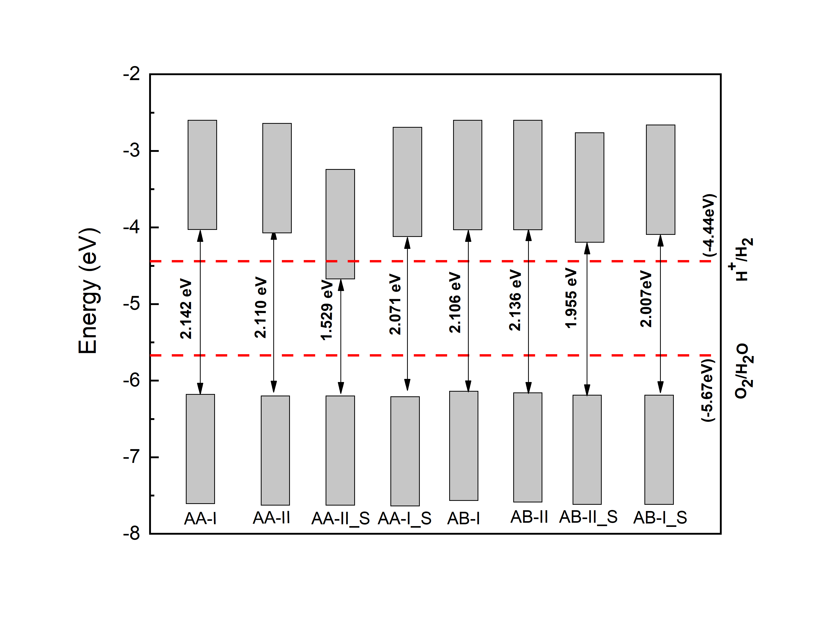
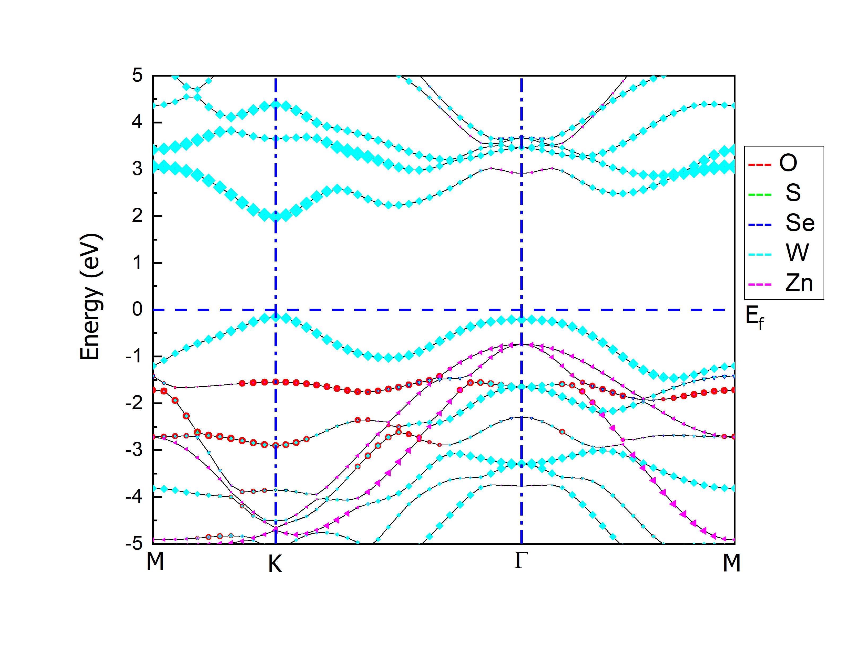
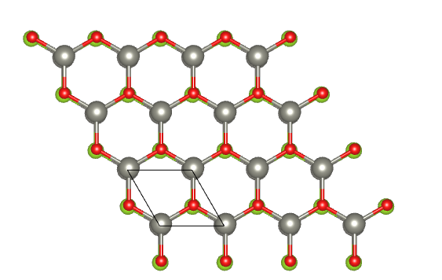
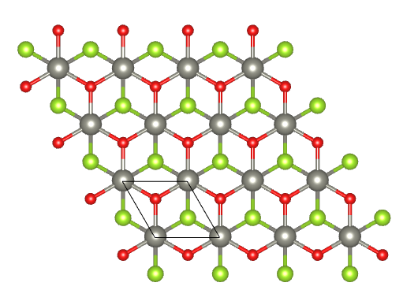
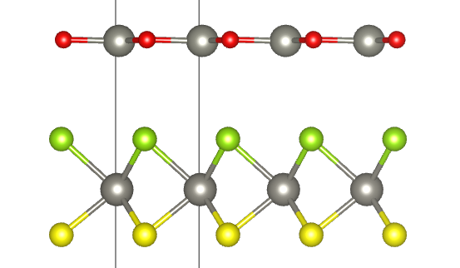
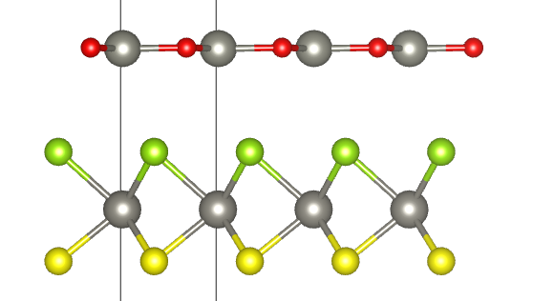
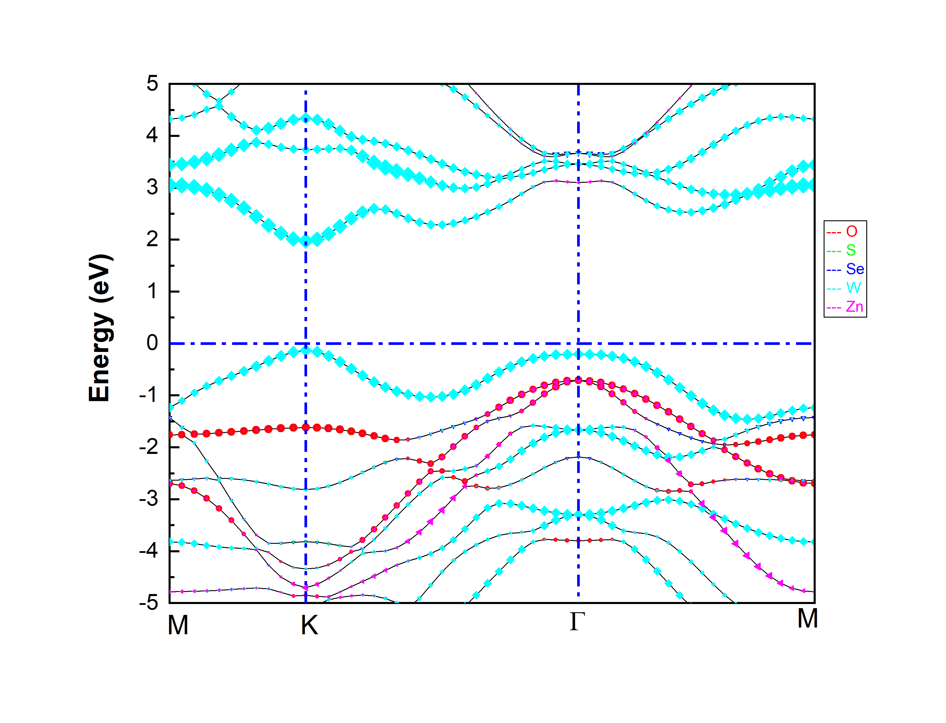
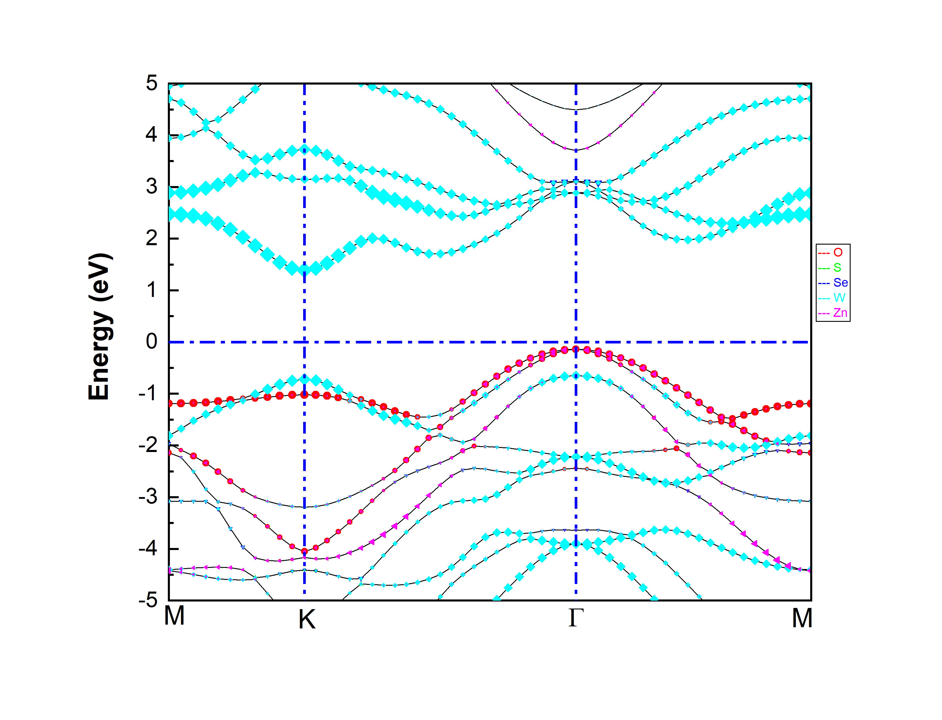
Promising photocatalytic performance and electronic properties of van der Waals Hetrostructure of ZnO-MoSSe
Georgies Alene, Tekalign T. Debela , Girma Mekonnen
Abstract
Results
The valance band (VB) and conduction band (CB) edge alignment of the hetrostructures. The red dashed-lines represent the standard oxidation and reduction potentials for water splitting.
Recently constructing a vertically stacking of two dimensional materials in to layered van der Waals hetrostructures are getting an interest because of their promising properties for photocatalytic and optoelectronics devices.
In this work we systematically investigated the geometric features, electronic properties, band alignment and photocatalytic properties of ZnO-MoSSe hetrostructures using first principle calculations.
Band Structure and band alignment
AA-I
AB-I
Conclusions
Why van der Waals Hetrostructures
We have explored the electronic and photocatalythic properties of the vdW hetrostructures of ZnO and MoSSe by first principle calculations.
Models reveal that type of alignment and band gap of the bands are different for different stacking. As we can see for instance type I direct band gap is obtained for AA-I and AB-I and indirect type II band gap alignment for AA-II_S configuration. Therefore it is possible to tune the band gaps and type by changing the stacking configuration.
The band edge position of the hetrostructures relative to the standard reduction and oxidation potential for water splitting at PH=0 is displayed. It can be seen except (AA-II_S) for all the hetrostructures both CB and VB edges are located more positive and more negative than the redox potential of H⁺/H₂ and O₂/H₂O. Therefore the energy level of CB and VB provides enough force to drive the photo generated electrons and holes to dissociate water into H⁺/H₂ and O₂/H₂O, thus making it promising material for photocatalytic water splitting.
The recent rapid developments in electronics, medicine, health care, energy production, environmental remediation and transportation have been fostered with the help of new nanomaterials and associated technologies
Being nanostructured and having desirable electronic properties, JTMDs nanostructures is expected to have a large specific surface area and is known to exhibit some catalytic behavior, prompting its analysis for photocatalytic material applications.
Combines advantages of the constituting structures.
AA-II_S
Methods
Density functional theory as implemented in VASP and QE code.
Quantum Espresso
VASP
Materials studio

